Slide 1
Pre-course Counselling Information Deck

Slide 2
Content Page
Pre-course Counselling Form
School and Course Information – Section B
Fee Payable and Payment Method – Section C
Fee Protection Schemes(FPS) & Student Contract – Section D
Refund/Transfer and Withdrawal Policy and Procedure – Section E
Singapore Regulations for International Students – Section F
Student Support Services – Section G
Committee for Private Education– Section H

Slide 3
School and Course Information

Slide 4
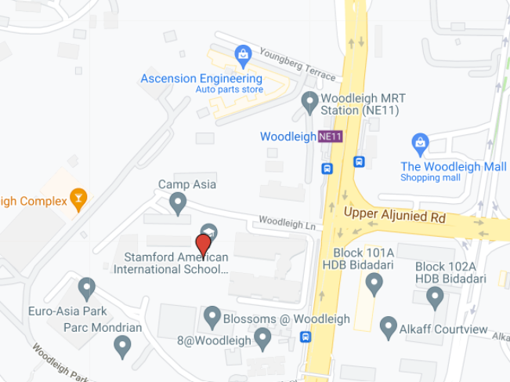
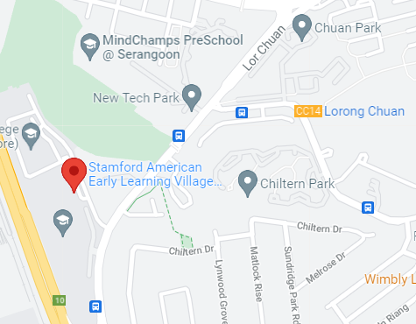
Location and Facilities
International students from more than 70 countries learn together at Stamford American’s stunning, bespoke campuses. Located just 10 minutes from popular Orchard Road, the Woodleigh Campus and Chuan Lane Campus welcome students from infant care to Grade 12. The campuses are conveniently linked by a shuttle bus service, making their unique facilities accessible to both parents and students.
Woodleigh Campus: 1 Woodleigh Lane (Off Upper Serangoon Road), Singapore 357684
Early Learning Village: 3 Chuan Lane, Gate 4, Singapore 554350
https://www.sais.edu.sg/contact-us/campus-locations-school-directions/

Slide 5
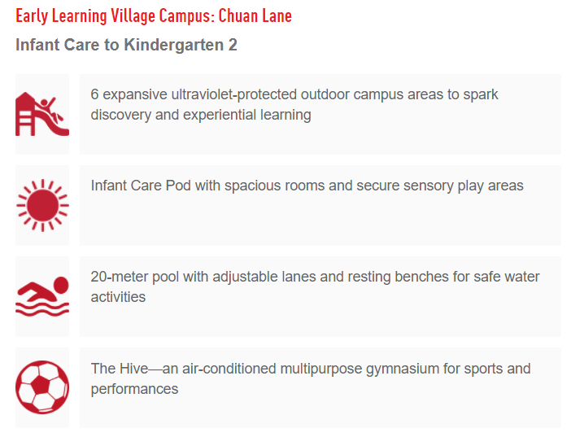
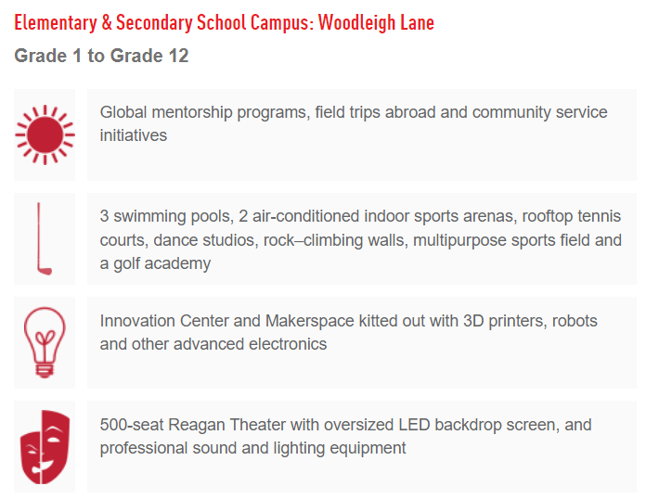
Location and Facilities
https://www.youtube.com/watch?v=fqnMxwVdOqc&t=9s

Slide 6
Stamford American International School – Course Information
School Divisions | Curriculums | Course Certificates | Programme Structure and Duration | Promotion Criteria
Early Years Pre-N to KG 2 | IB Primary Year Programme(PYP) | N.A | Early Years | Continuous assessments Attendance fulfilment
Elementary School Grade 1 to Grade 5 | IB Primary Year Programme(PYP) | IB PYP Certificate | Elementary School | Continuous assessments Attendance fulfilment
Middle School Grade 6 to Grade 10 | IB Middle Year Programme(MYP) | IB MYP Certificate | Middle School | Continuous assessments Attendance fulfilment

Slide 7
Stamford American International School – Course Information
School Divisions | Curriculums | Course Certificates | Programme Structure and Duration | Promotion Criteria
High School Grade 11 to Grade 12 | Advanced Placement, International Baccalaureate, BTEC, Stamford Course | IBDP APDP BTEC Stamford DP | High School | https://www.sais.edu.sg/curriculum/secondary-school/
Preparatory Course for Secondary School (PCS) Grade 6 to Grade 10 | Stamford Preparatory Course for Secondary School | PCS Completion Certificate | PCS | https://www.sais.edu.sg/pcs/

Slide 8
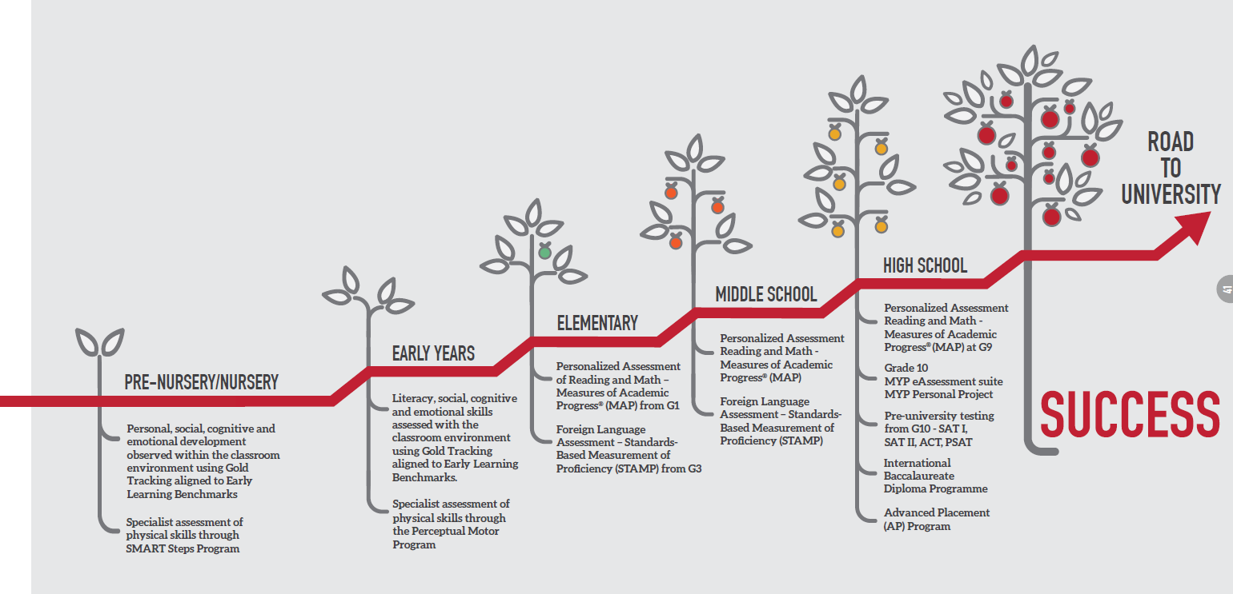
Opportunities for Further Education
A Stamford American learning journey is a pathway which is grounded in the International Baccalaureate (IB) Programme underpinned by American Standards. We carefully plan each and every step, so students are set up for success here in Singapore, and in the wider world
https://www.sais.edu.sg/university-offers-2021/

Slide 9
Application Procedures and Requirements
Stamford American International School accepts applications on a rolling basis throughout the year, subject to availability of spaces. We aim to make the application process a pleasant, straightforward experience. The application form and supporting documents can be submitted online through our online application system and by following the steps below. Please note, we do not hold spaces and places are not confirmed until you receive an official letter from our enrollments team.
To inquire about availability or to visit Stamford, please contact the Admissions Department at +65 6602 7247 or fill out our inquiry form.
To apply, please follow these steps:
Complete and submit the online application form and attach the required documents.
Complete payment of Application fee ($851 SGD per applicant). Please note this is non-refundable under any circumstances
https://www.sais.edu.sg/admissions/application-process/
Notes:
additional liner on website to direct to application page

Slide 10
Admissions Procedures and Requirements
After acceptance into Stamford, and before starting school you will need to provide the following:
Signed Student Contract**
Once an offer is made, a link will be emailed to sign the student contract which secures the students space. This must be completed within seven (7) days of receipt of the email or priority will be given to other applicants and the space may be forfeited.
2. Settlement of remaining Enrollment, Facility and Tuition fees
Fees must be paid within seven calendar (7) days of receipt of the invoice or as per fee schedule.
3. Photocopy of Valid Visa
Students must be in possession of a valid visa before starting school.
https://www.sais.edu.sg/admissions/application-process/

Slide 11
Admissions Procedures and Requirements
Wait List
We are currently at capacity in some grade levels. If a place is not available at the time you wish to join, you will be invited to go on our waitlist. Payment of the $3,685 enrollment fee will secure your space on the list. Please note that this fee is fully refundable if at any time you wish to be removed from the list. If you are offered a space and decide not to accept, the fee is non-refundable.
Sibling Priority
Stamford aims to welcome all family members into our community. As such, admissions priority is given to families with siblings. Siblings will also be given priority should there be a waitlist in their grade level.
Singapore Nationality/Singapore Passport Holders
Approval is required from the Ministry of Education (MOE) before a Singaporean student (6 years old and above) is allowed to attend classes at Stamford. The application for approval from the MOE will be sent as soon as a student is accepted. Please note that Singaporean applicants who are 6 years old and above will be accepted onto our waitlist and no place will be reserved for the student until formal approval has been granted by the MOE.
https://www.sais.edu.sg/admissions/application-process/

Slide 12
Admissions Procedures and Requirements
Vaccination Requirements (for age 12 years and below)
The Ministry of Health (MOH) of Singapore has introduced diphtheria and measles vaccination requirements as a prerequisite for foreign-born children applying for long-term immigration passes to Singapore, with effect 1 February 2019.
Foreign-born children aged 12 years old and below, who are first-time applicants for Dependent's Pass (DP), Long Term Visit Pass (LTVP), and Student Pass (STP) are required to submit documentary proof of vaccination or evidence of immunity for diphtheria and measles to the Health Promotion Board (HPB) for before they can proceed with their visa or pass application. Further details and the application form can be found on the HPB website.
Specialized Support Program
Stamford offers a Specialized Support Program for students who require support for learning differences. The needs of eligible students will be assessed on an individual basis and parents should discuss their situation with the Admissions Office prior to making an application.
https://www.sais.edu.sg/admissions/application-process/

Slide 13
Fee Payable and Payment Methods

Slide 14
Fees Payable and Payment Methods
Fees Information:
https://www.sais.edu.sg/admissions/fees/
Payment Instruction:
https://www.sais.edu.sg/wp-content/uploads/sites/14/2022/08/Payment-Option-2021-_-Final-V1-1.pdf

Slide 15
Fee Protection Scheme(FPS) and Student Contracts

Slide 16
Fee Protection Scheme
The Fee Protection Scheme (FPS) serves to protect students’ fees in the event a private education institution is unable to continue operating due to insolvency, and/or regulatory closure.
The FPS is applicable to all students regardless of nationality and the type of passes held by the students, i.e. dependent’s pass, student’s pass, work permit etc.
In compliance with the new regulations under the Private Education Act 2009, all students' fees must be insured under the Fee Protection Scheme (FPS). All Stamford students are now covered by way of Insurance Protection as stipulated by the Council for Private Education. The Fee Protection Scheme serves to protect the course fees that are paid to Private Education Institutes in Singapore. Fees are only considered protected once they are paid to Stamford. Stamford then activates the insurance policy with the appointed provider. The provider will then issue a certificate to the family indicating the amount covered and the period of coverage. Stamford has appointed LONPAC Insurance Bhd to be the FPS provider for our students.
FPS Insurance Certificate
FPS Insurance Policy
For more information on the Fee Protection Scheme please email finance@sais.edu.sg.
https://www.sais.edu.sg/about-us/accreditation/cpe/

Slide 17
Student Contract
Stamford is required to execute a contract with each and every student prior to being enrolled in the school. As most of our students are under 18 years of age, a parent or the legal guardian is required to execute the contract on behalf of the student. The Stamford-Student Contract is an important legal agreement between Stamford and parents. Students are not considered fully enrolled at Stamford until a duly-executed contract and Advisory Note (Form 12) is submitted on-line by the parent to the school.
You should only sign this contract if you fully understand and are satisfied with all of the terms and conditions detailed therein. If you have any doubts about the contents of the contract, you should seek advice and clarification before signing. Detailed sections within the Stamford-Student Contract include course information and fees, refund policy, fee protection scheme, medical insurance scheme and additional information relating to the governing law and dispute resolution.
Should you require any additional information, do not hesitate to contact Stamford at +65 6602 7247 or by email at accreditation@sais.edu.sg.
https://www.sais.edu.sg/admissions/application-process/

Slide 18
Refund/Transfer & Withdrawal Policy and Procedure

Slide 19
Refund Policy and Procedure
Non-Refundable Application and Enrollment Fee
The Application Fee is strictly non-refundable and non-transferable.
The Enrollment Fee is non-refundable and non-transferable except in the following circumstances:
Stamford is unable to offer a place to a student applicant due to denial of student pass or approval by the relevant Singapore authorities.
Stamford is unable to offer a place to a student applicant due to waitlist for the relevant year level and the student applicant elects not to be placed on the waitlist.
Student applicant does not meet the eligibility criteria for enrollment at Stamford.
Stamford is unable to offer a place to a student applicant due to sibling priority policy as published by Stamford.
The Enrollment Fee will be refunded in full in the event a student applicant cannot be accepted at Stamford for the reasons set out in 1 to 4 as determined by Stamford in its sole discretion.
https://www.sais.edu.sg/about-us/accreditation/cpe/

Slide 20
Refund Policy and Procedure
Refund for Withdrawal Due to Non-Delivery of Course:
The PEI will notify the Student within three (3) working days upon knowledge of any of the following:
It does not commence the Course on the Course Commencement Date;
It terminates the Course before the Course Commencement Date;
It does not complete the Course by the Course Completion Date;
It terminates the Course before the Course Completion Date;
It has not ensured that the Student meets the course entry or matriculation requirement as set by the organization stated in Schedule A within any stipulated timeline set by CPE; or
The Student’s Pass application is rejected by Immigration and Checkpoints Authority (ICA)
In relation to Singapore citizens, approval has not been received from Ministry of Education (MOE).
The Student should be informed in writing of alternative study arrangements (if any), and also be entitled to a refund of the entire Course Fees and Miscellaneous Fees already paid should the Student decide to withdraw, within seven (7) working days of the above notice.
https://www.sais.edu.sg/about-us/accreditation/cpe/

Slide 21
Refund Policy and Procedure
Non-Refundable Facility Fee
The Facility Fee is payable in full at the time of acceptance in order to secure a place. If payment is not received within 7 calendar days of receipt of the school’s invoice, priority will be given to other applicants. The Facility Fee is a one-time administrative fee that is non-refundable. The full amount applies regardless of enrolment date.
Refund for Withdrawal Due to Other Reasons:
If the Student withdraws from the Course for any reason other than those stated in Clause 2.1, the PEI will, within seven (7) working days of receiving the Student’s written notice of withdrawal, refund to the Student an amount based on the table in Schedule D of the PEI Student Contract.
Refund During Cooling-Off Period:
The PEI will provide the Student with a cooling-off period of seven (7) working days after the date that the Contract has been signed by both parties and
Notwithstanding Schedule D of the PEI Student Contract, the Student will be refunded all fees already paid if the Student submits a written notice of withdrawal to the PEI within the cooling-off period, regardless of whether the Student has started the course or not.
https://www.sais.edu.sg/about-us/accreditation/cpe/

Slide 22
Refund Policy and Procedure
Third Party Mediation
In the event that the Student and the PEI are unable to resolve a dispute in accordance with the grievance procedure referred to in Clause 5.2, the Student and the PEI may refer the dispute to the Singapore Mediation Centre (SMC) or Singapore Institute of Arbitrators (SIArb) through the CPE Student Services Centre (SSC) www.ssg.gov.sg/cpe/student-services/dispute-resolution.html or email cpe_contact@cpe.gov.sg for mediation prior to instituting any legal action. The Student and the PEI hereby agree to such procedures and to pay such fees as the Singapore Mediation Centre (SMC) or Singapore Institute of Arbitrators (SIArb) may prescribe from time to time for the purpose of resolving their dispute.
Response Time for Feedback/Complaint
The PEI shall respond to any feedback or complaint, received in writing, within 21 days of the date of such feedback/complaint.
https://www.sais.edu.sg/about-us/accreditation/cpe/

Slide 23
Student Transfer and Withdrawal Policies
Withdrawal requests may come from various forms from the parent community; however, the Customer/Parent Experience team will direct families to submit an official Withdrawal Form found on the School Portal, at https://mystamford.edu.sg/forms-1/withdrawal-form/withdrawal-form
Once the withdrawal form is completed and received by the Customer/Parent Experience Team, a confirmatory email will be sent to the parent. The withdrawal will be completely processed within 14 days of receiving written withdrawal from the parent.
Finance works directly with the family and follows the “Finance refund process.
The Customer/Parent Experience Team, will then, during the students last week, advise the offboarding process via email for the following to be returned:
Return of borrowed items such as iPad, laptops, musical instruments, library books and sporting equipment.
Return of wristbands, ID cards and Car Decals
Student and family card balances are managed with Sodexo and refund made directly by Sodexo.
Parents will be asked to provide future contact details –in the event SAIS needs to contact them after departure.

Slide 24
Singapore Regulations For International Students

Slide 25
Student Pass Application Procedure
Stamford will register a child requiring a Student Pass with the Immigration and Checkpoints Authority (ICA) after acceptance and parents will process the application from there. Student Pass holders can commence classes after the student ID has been issued. Student Pass holders must meet the minimum 90% monthly attendance requirements stipulated by the ICA.
Click on the link for more information on STP Application procedures:
ICA – Student Pass Application portal with list of documents required https://eservices.ica.gov.sg/esvclandingpage/solarplus
Terms and Conditions
Student Pass (SP)
https://www.sais.edu.sg/about-us/accreditation/cpe/

Slide 26
Useful Information and Links on Singapore Laws and Regulations
Immigrations and Checkpoints Authority of Singapore: www.ica.gov.sg
Working and Employment in Singapore: www.mom.gov.sg
Traffic Laws and Driving in Singapore: www.lta.gov.sg
Singapore Drug Law: https://www.mha.gov.sg/what-we-do/keeping-singapore-drug-free
Alcohol Abuse: Purchase and consumption of alcohol is prohibited for people below 18 years of age
Smoking Laws In Singapore: http://app2.nea.gov.sg/index.aspx
Smoking and use of tobacco products are prohibited for people below 18 years of age. It is an offence for a person to smoke in non-smoking areas and indoor premises listed under the Smoking (Prohibition in Certain Places) Act. (refer to the Section on “Smoking Prohibition”). Possession, purchase, sale and distribution of Contraband cigarettes is an offence in Singapore.
Laws on Littering: https://sso.agc.gov.sg/Act/EPHA1987#pr17-
Littering and Spitting in public places are serious offences that could lead to a fine and community work.

Slide 27
Medical Insurance
Stamford American International School Ltd Pte has a medical insurance scheme in place for all students. The student’s parent/guardian is encouraged to seek advice on whether more comprehensive insurance cover is required or desired. This scheme provides a basic annual coverage limit of not less than $20,000 per student in B1 ward in government and restructured hospitals and up to overall maximum limit per policy year, with 24 hours coverage in Singapore and overseas (if the student is involved in the school-related activities) throughout the course duration as required by the Council for Private Education (CPE) under the EduTrust certification scheme. Stamford has appointed Sime Darby Insurance Brokers (Singapore) Pte Ltd. as the medical insurance provider for our students.
Please download the following documents for more information on the Stamford Medical Insurance Scheme:
Medical Insurance Claim Form
Medical Certificate of Insurance and Policy
Medical Policy & Benefit Schedule
https://www.sais.edu.sg/about-us/accreditation/cpe/

Slide 28
General Healthcare Service in Singapore
Primary Healthcare Services:
https://www.moh.gov.sg/home/our-healthcare-system/healthcare-services-and-facilities/primary-healthcare-services
All Healthcare Services and Facilities:
https://www.moh.gov.sg/home/our-healthcare-system/healthcare-services-and-facilities
https://www.sais.edu.sg/admissions/boarding/

Slide 29
Student Support Services

Slide 30
Student Support Services
Students may sometimes need extra support as they navigate through school, social life and the other aspects of growing up. The Student Support Department at Stamford American offers a helping hand to all students in managing any academic, emotional, physical or developmental challenges that come their way.
Through a Response to Intervention (RTI) approach, we seek to identify learning and behavioral needs early. We then work towards offering the appropriate support services to our students through our team of counselors, therapists and teachers. Our areas of support are:
Early Intervention
This powerful and proactive student support service program addresses social-emotional, language, cognitive and motor development concerns among young learners at the Early Learning Village.
Academic Support
Students who face academic performance issues have access to remedial lessons to bring them up to par with their peers. Academic support teachers work closely with classroom teachers to design weekly small-group sessions that give students a boost in mastering their subject areas.
https://www.sais.edu.sg/programs/student-support/

Slide 31
Student Support Services
Math Extension
For students who are not yet numbers-oriented, additional small-group instruction is available to give them a better grasp of mathematical concepts taught at their grade level.
Counseling
The Student Support Department runs a comprehensive program to help students overcome social and emotional hurdles. Counseling services are both preventative and responsive, and are administered through individual and group counseling, Check-In/Check-Out (CICO) intervention and school-wide awareness drives.
Speech and Language Therapy
Speech therapists are available for students who experience difficulty in communicating with others. Through a language and communication program, students learn strategies for effective communication inside and outside the classroom.
https://www.sais.edu.sg/programs/student-support/

Slide 32
Student Support Services
Occupational Therapy
Whether a student has trouble holding a pencil or paying attention in class, our occupational therapists are on hand to guide students in effectively and happily participating in all areas of school life.
Intensive Support
In cases where students needs exceptional support services, Special Education teachers get involved in designing individualized programs. These programs will tap on the expertise of a range of education specialists depending on the needs and progress of each student.
https://www.sais.edu.sg/programs/student-support/

Slide 33
Committee for Private Education (CPE)

Slide 34
Committee for Private Education
In alignment with the Private Education Act 2009, Committee for Private Education (CPE) has been established in Singapore to regulate the private schools in Singapore. All Private Education Institutes (PEIs) are required to comply with the regulations under the new Act in order to operate. Through the CPE, private schools are invited to apply for EduTrust certification. EduTrust is a voluntary certification scheme that helps to distinguish higher quality educational institutions in Singapore’s private education industry. Private Education Institutions (PEIs) need to be EduTrust certified before being able to offer placement for international students who require Student Passes from the Immigration and Checkpoints Authority (ICA).
For more details about the EduTrust Certification Scheme or Private Education in Singapore, please visit website of Committee for Private Education (CPE): www.ssg.gov.sg/cpe/pei.html
https://www.sais.edu.sg/about-us/accreditation/cpe/

